Slide 1


MINI PROJECT
CRYPTOGRAPHY MACHINE
ADITYA GUPTA
DHEERAJ KUMAR

Slide 2
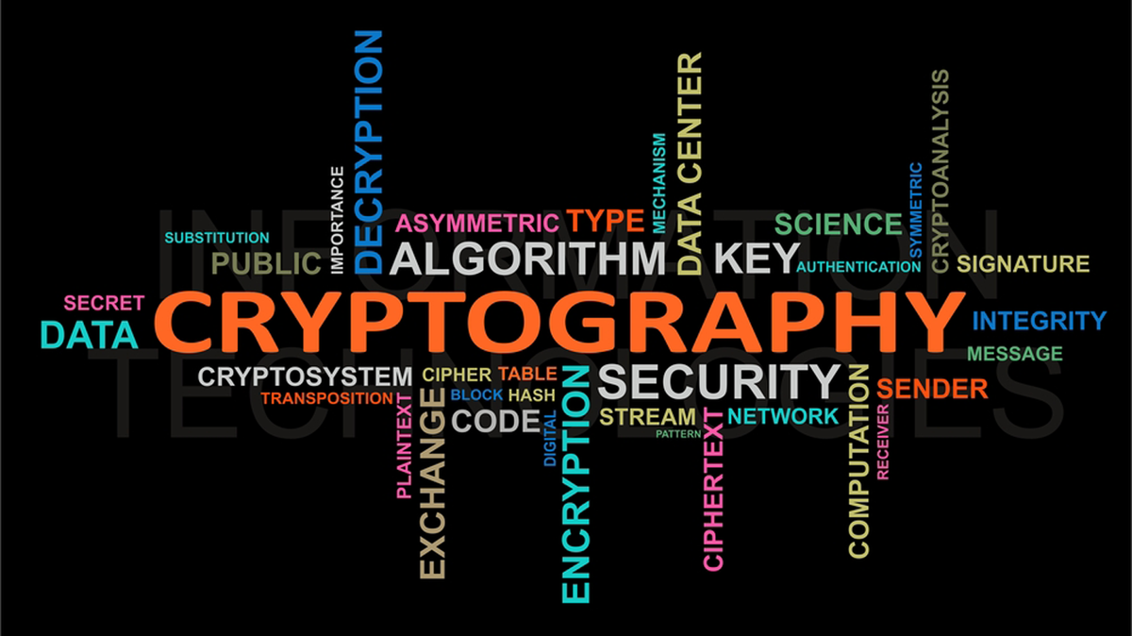
What is Cryptography?
Cryptography is a process which is mainly used for safe and secure communication. It works on different mathematical concepts and algorithms to transfer the encoded data into a secret code which is difficult to decode.

Slide 3
Uses of Cryptography
Data Transmission
Data is at risk when it is in motion (during transmission). The risk occurs when unauthorized persons attempt to intercept, copy, modify, corrupt or delete the data. There has to be secrecy in data transmission, which is one of the uses of cryptography. Transmission always involves two parties: a sender and a receiver. For the secrecy to be effective during transmission, the data has to be encrypted (encoded) from the moment it leaves the sender until it successfully reaches the receiver. Encryption is defined as the process of converting data from the normal, readable format into an encoded format which is unreadable by others. The encrypted data can only be accessed and read by the parties in possession of the decryption (decode) key. Figure 1 shows cryptography in data transmission with the sender possessing the encryption (Key A) and the recipient possessing the decryption (Key B).

Slide 4
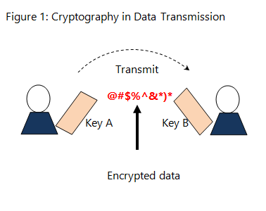
Data Storage
Data in storage refers to data at rest (on a storage device). Our storage devices are very sensitive. In our current society, computers have practically been replaced by smart devices. This means that these devices contain tons of sensitive data from our daily activities. Secrecy in storage is achieved by storing of information in an encrypted form. This way, unauthorized intruders to the system will be presented with gibberish as data, thereby preventing any data compromises. In the absence of the correct key, the data is inaccessible.

Slide 5
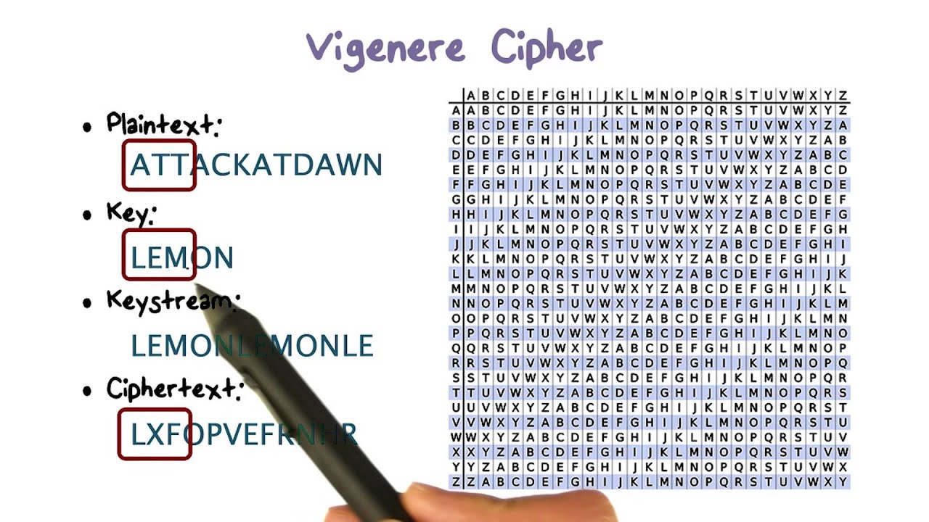
What is Vigenere Cipher?
Vigenere Cipher is a method of encrypting alphabetic text. It uses a simple form of polyalphabetic substitution. A polyalphabetic cipher is any cipher based on substitution, using multiple substitution alphabets . The encryption of the original text is done using the Vigenere square or Vigenere table.

Slide 6
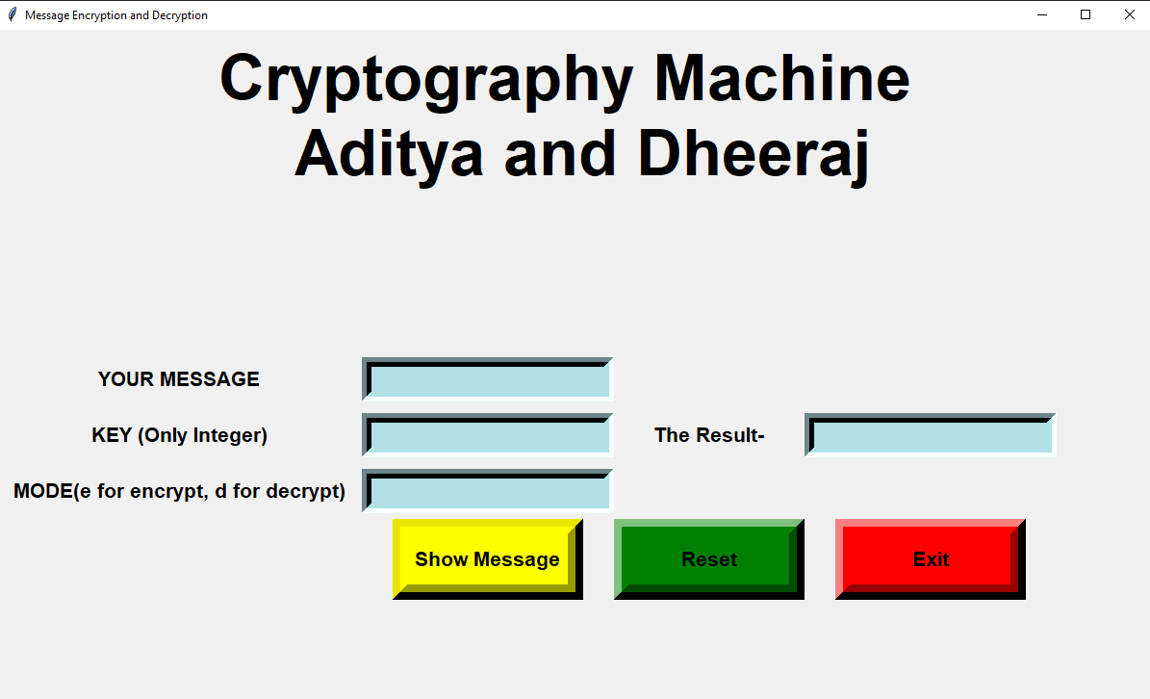
PROTOTYPE
Enter your message
Result will show here
Reset Button

Slide 7
THANK YOU

